Slide 1
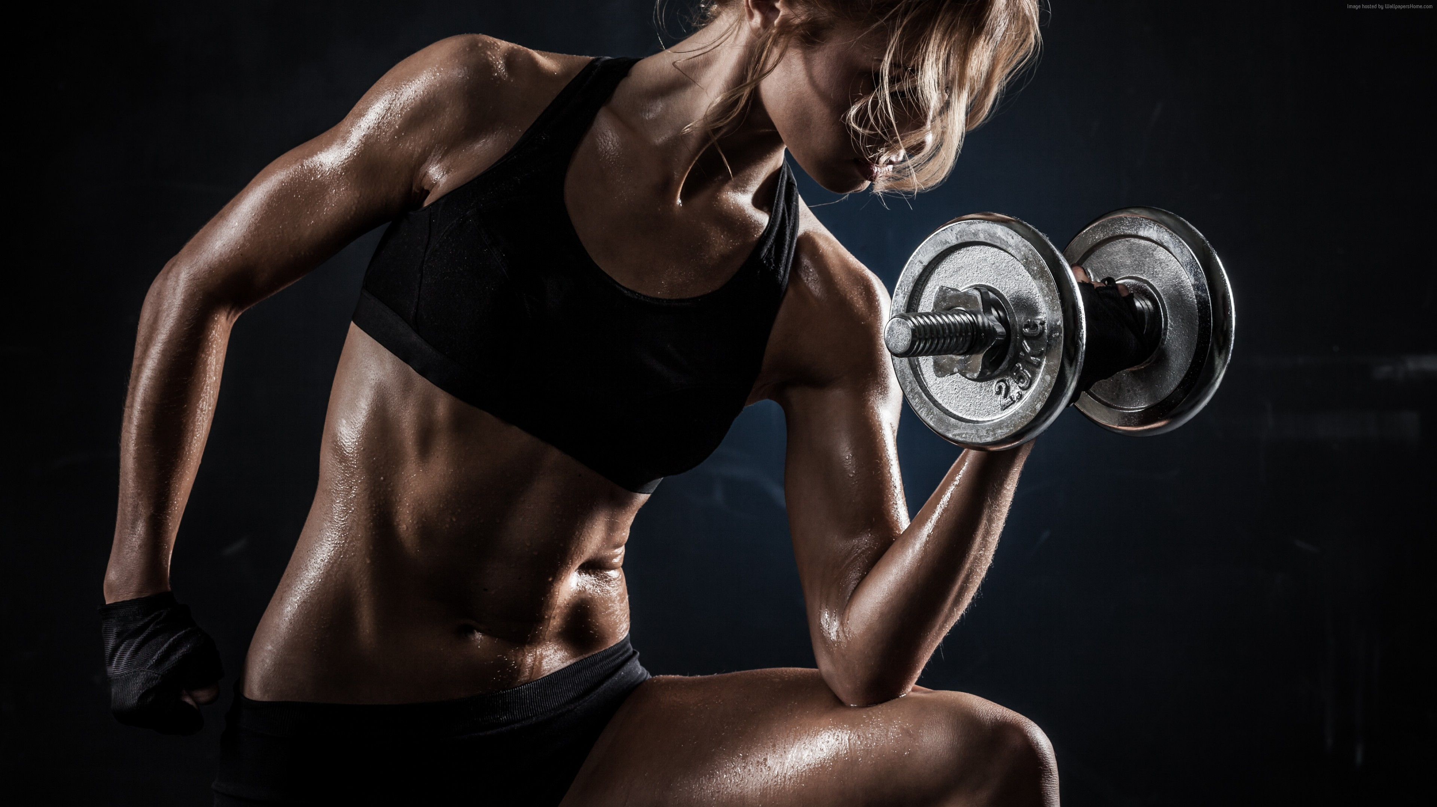
No pain No gain
Pave your way to strength with our group classes training program

Slide 2

Join the party

Slide 3


